Slide 1

Shepherding
a Child’s Heart
Tedd Tripp

Slide 2
Session One
Getting to the Heart of Behavior

Slide 3
Above all else,
guard your heart,
for it is the wellspring
of life.
Proverbs 4:23

Slide 4
Activities of the Heart
Think Hate Love God
Remember Lust Faithful
Know Love Upright
Discern Give Deceive
Store things Turn away/to Set up idols
See Pray Become hard
Meditate Rejoice Seek God
Fear Become proud Repent
Grieve Sing Believe
The grace of the New Covenant is a new heart

Slide 5
Implications for
Understanding Behavior
1. The activities of heart drive behavior.
2. Great areas in which to develop questions for kids.
3. Good Bible study for family.

Slide 6
Major Old Testament Thread of Truth
1 Samuel 16:7
Deuteronomy 10:12
1 Chronicles 28:9
Proverbs 3:5-6
2 Chronicles 16:9
1 Kings 8:57-58

Slide 7
Overflow
Matt 15:17-20
Mark 7:20-23
Luke 6:43-45
Behavior
(say and do)
Behavior
(say and do)

Slide 8
Behaviorism Evaluated
1. Real need is not addressed
2. False basis for ethics
3. The heart is wrongly trained
4. The gospel will not be central
5. Shows our idols of heart control pride ease convenience fear of man

Slide 9
Ungodly Attitudes Godly Attitudes
vengeance entrusting to God
fear of man fear of God
pride humility
love of self love for others
self-preservation laying down life
fear perfect love
covetousness generosity
envy good of others
hatred love
anger peace-making
bitterness forgiveness
approval God’s approval
anxiety & fear peace & contentment
rebellion submission

Slide 10
Shepherding the Heart
Bible reveals heart Hebrews 4:12
Behavior is heart-driven James 4:1
Help your kids understand the heart
Psalm139:22-24 Psalm 26:2

Slide 11
Profound need for grace
Key text: Ezekiel 36:25-27
  We need cleansing
  We need to have our idols removed
  We need heart transplant
  Replacing stone with flesh
  We need empowerment by Spirit

Slide 12
Getting to the Heart of Behavior
How does thinking of the heart as the well-spring of life and not just the emotions broaden your understanding of the heart?
What questions could you ask of your children to help them understand their hearts?
How are you tempted to hang apples on the tree?
In what ways does depending on behaviorism keep us from depending on the gospel?
What are some of the idols of the heart that motivate you in relationship to your children?

Slide 13
Session Two
Early Childhood: Living Joyfully Under Authority

Slide 14
Early Childhood - radical change
Physical development
Social development
Intellectual development
Spiritual development

Slide 15
Eph. 6:1-3, Children, obey your parents in the Lord, for this is right. “Honor your father and your mother” – which is the first commandment with a promise that it may go well with you and that you may enjoy long life on the earth.
Obey
Go
well
Long
life
Honor
Circle of Blessing

Slide 16
Misunderstanding About Authority
Authority - standing over someone;
telling them what to do.
We question the fairness of that,
so many parents give away their authority.

Slide 17
Authority In a Biblical Vision
God calls me to authority in the lives of my kids.
Gracious authority is a blessing to them, they lack:
Wisdom
Maturity
Life experience

Slide 18
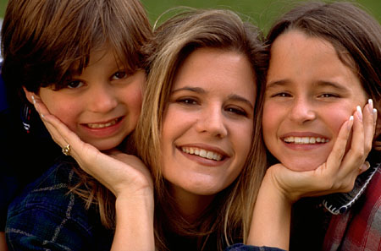
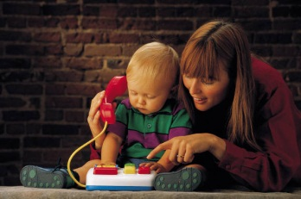

Definitions
Obey - submission to God’s authority that causes a child to do what he is told by his parents immediately, without excuse, without complaint and without question.
Honor - submission to God’s authority that causes a child to speak to his parents with respect for their role as God’s agent of nurture, direction and discipline

Slide 19
Definitions
Go well - the spiritual blessings that come to a child as he lives under God’s authority; along with the natural blessings that come as the adults in his world recognize that he is obedient and trustworthy.
Long life - the blessings of prosperity and protection, richness and fullness of life that God provides for the child that lives under His structures of authority.

Slide 20
Eph 6:1 Children, obey your parents in the Lord, for this is right.”
Honor
Danger
dishonor
Go Long
Well Life
disobey
discipline
Obey
correction
Discipline - a rescue mission aimed at returning the child to the circle of blessing. The function of discipline is not punitive, but corrective. Its goal is positive not negative.

Slide 21
Do Not Withhold Discipline
Proverbs 13:24 Proverbs 19:18 Proverbs 22:15 Proverbs 23:13-14 Proverbs 29:15 & 17
The warning of Colossians 2:8-9
must be taken seriously
The Bible is not unclear about spanking children; it is just an unpopular thing to do in our culture

Slide 22
THE “HOW” OF SPANKING
1. Take your child to a private place.
2. Tell him specifically what he has done or failed to do.
3. Secure an acknowledgement.
4. Remind him that your objective is
restoration to the circle of blessing.

Slide 23
THE “HOW” OF SPANKING
5. Tell him how many swats he will receive.
6. Remove his drawers.
7. Restoration - tell him how much you love him.
8. Pray with him.

Slide 24
Common Questions About Spanking
When do you spank?
What do you use?
When is a child old enough?
What if I am too mad?
What if we are not at home?
What if he did not hear me?
When is a child too old?
What if it doesn’t work?
Can I use time out instead?
What about special needs kids?
What about adoption / foster care?
If I listen to you, all I’ll ever do is spank kids.
What if it is too late?

Slide 25
Ages 0-5, Living Joyfully under Authority
Why do we tend to leave God out of the picture when we talk to children about obedience?
How could helping your children see that obeying God is the pathway to blessing change the way you talk to your children about obeying?
What are the ways you are tempted to give away your authority?
Describe how thinking of discipline as restoration rather than punishment could change your approach to discipline.
There is hope found in knowing that Jesus was inside the circle for us: how can you make gospel encouragement a part of your discipline (discipling) process with your children?

Slide 26
Session Three
Childhood: Identifying Attitudes of the Heart

Slide 27
Heart Directs Behavior
Overflow
Matt. 15:17-20
Luke 6:43-45
Mark 7:17-23
Behavior
(say & do)
What our kids say and do flows from the heart. Prov. 4:23
Behavior can never be understood in isolation from the heart

Slide 28
Heart Directs Behavior
Overflow
Ungodly behavior Godly behavior
Attitude Attitude
Behavior Behavior
Fighting Sharing
Matt. 15:17-20
Luke 6:43-45
Mark 7:17-23
Behavior
(say & do)
What our kids say and do flows from the heart. Prov. 4:23
Behavior can never be understood in isolation from the heart

Slide 29
Heart Directs Behavior
Overflow
Ungodly behavior Godly behavior
Attitude Attitude
Behavior Behavior
Fighting Sharing
Love of self Love of others
Matt. 15:17-20
Luke 6:43-45
Mark 7:17-23
Behavior
(say & do)
What our kids say and do flows from the heart. Prov. 4:23
Behavior can never be understood in isolation from the heart

Slide 30
Heart Directs Behavior
Overflow
Ungodly behavior Godly behavior
Attitude Attitude
Behavior Behavior
Fighting Sharing
Love of self Love of others
Matt. 15:17-20
Luke 6:43-45
Mark 7:17-23
Behavior
(say & do)
What our kids say and do flows from the heart. Prov. 4:23
Behavior can never be understood in isolation from the heart

Slide 31
Heart Directs Behavior
Overflow
Ungodly behavior Godly behavior
Attitude Attitude
Behavior Behavior
Fighting Sharing
Love of self Love of others
Matt. 15:17-20
Luke 6:43-45
Mark 7:17-23
Behavior
(say & do)
What our kids say and do flows from the heart. Prov. 4:23
Behavior can never be understood in isolation from the heart

Slide 32
Heart Directs Behavior
Overflow
Ungodly behavior Godly behavior
Attitude Attitude
Behavior Behavior
Fighting Sharing
Love of self Love of others
Matt. 15:17-20
Luke 6:43-45
Mark 7:17-23
Behavior
(say & do)
What our kids say and do flows from the heart. Prov. 4:23
Behavior can never be understood in isolation from the heart

Slide 33
Heart Directs Behavior
Overflow
Ungodly behavior Godly behavior
Attitude Attitude
Behavior Behavior
Fighting Sharing
Love of self Love of others
Matt. 15:17-20
Luke 6:43-45
Mark 7:17-23
Behavior
(say & do)
What our kids say and do flows from the heart. Prov. 4:23
Behavior can never be understood in isolation from the heart

Slide 34
Heart Directs Behavior
Ungodly behavior Godly behavior
Attitude Attitude
vengeance entrusting self to God
fear of man fear of God
pride humility
love of self love of others
self-preservation laying down life
fear perfect love
covetousness generosity
envy good of others
hatred love
anger peacemaking
bitterness forgiveness
approval God’s approval
anxiety & fear peace & contentment
rebellion submission
Overflow
Matt. 15:17-20
Luke 6:43-45
Mark 7:17-23
Behavior
(say & do)

Slide 35
Heart Directs Behavior
Overflow
Ungodly behavior Godly behavior
Attitude Attitude
Behavior Behavior
Fighting Sharing
Love of self Love of others
Matt. 15:17-20
Luke 6:43-45
Mark 7:17-23
Behavior
(say & do)
What our kids say and do flows from the heart. Prov. 4:23
Behavior can never be understood in isolation from the heart

Slide 36
Heart Directs Behavior
Ungodly behavior Godly behavior
Attitude Attitude
Behavior Behavior
Fighting Sharing
Overflow
Love of self Love of others
repent
faith
Matt. 15:17-20
Luke 6:43-45
Mark 7:17-23
Behavior
(say & do)

Slide 37
Ages 6-12, Understanding Attitudes of Heart
Identify ways that you focus on behavior rather than the heart?
How does behaviorism appeal to things in our children that are wrong?
How do you tend to focus more on cleaning the outside of the cup rather than the inside?
Why does focusing on behavior and missing the heart create a temptation to hypocrisy toward our children?
Why is it always easier to get to the gospel when we focus on the heart?
How does standing in solidarity with our children in their struggle make it easier to bring them the hope of the gospel?

Slide 38
Session Four
Teenagers: Embracing Gospel Living as Living Faith

Slide 39
TEENS: AN OVERVIEW
Insecurity
Vulnerability
Instability
Apprehension
Tendency to resistance

Slide 40
Teens: Common Pitfalls for Parents
“Cops and Robbers ”
Disengaging
Authoritarianism vs. Influence
Reckless Words
Majoring on minors
(short-circuiting on behavior)

Slide 41
GOALS WITH OUR TEENS
Internalization of the Gospel – embrace God’s truth as their own living faith.
Shepherding and nurturing my teens interaction with the Word of God. Helping them see the wisdom and vitality of ways of God.
Shepherding through the periods of doubt.
Developing a relationship that leads to mutuality as adults under God.

Slide 42
Questions to ask of any passage
What do we learn about God, his plan, character?
What do we learn about us, our nature, struggles?
What do we learn about the purpose of our lives?
What do we learn about good, bad, falsehood, truth?
What do we learn about right and wrong?
What do we learn about relationships, love, authority?
What do we learn about the heart, the inner man?
What do we learn about how to critique the culture?
What do we learn about to live and make decisions?

Slide 43
Foundations from Proverbs 1
Proverbs 1:7 Fear of the Lord. Show the greatness and excellence of God.
    Proverbs 1:8-9 Remembering your parent’s words. Remind them that no one loves them like you do.
    Proverbs 1:10-19 Disassociation from the wicked. The attraction of association with the wicked is camaraderie – a sense of belonging. Make home a great place to belong.

Slide 44
Communication
The finest art of communication is not the ability to express your thoughts and ideas; it is the ability to understand the thoughts and ideas of your kids.
Proverbs 18:2 A fool finds no pleasure in understanding but delights in airing his own opinions.
Proverbs 18:13 He who answers before listening -- that is his folly and his shame.
Proverbs 20:5 The purposes of a man's heart are deep waters, but a man of understanding draws them out.

Slide 45
2 Peter 1:3-4
All the grace to do all that God calls you to as a parent has been given to you by Jesus Christ

Slide 46
Teens: Embracing the Gospel as Living Faith
As a teen did you experience insecurity, vulnerability, instability, apprehension, resistance to authority? How can you use your life experience to encourage your teenager?
Which of the pitfalls for parents of teens (cops and robbers, disengaging, authoritarianism vs. influence, reckless words, majoring on minors) is a tendency for you?
What growth in you would facilitate your nurture of your teen with the robust truth of the gospel?
How can you prepare to shepherd your teens through the inevitable periods of doubt?
Which of the three foundations for teenagers from Proverbs 1 do your teens need the most? How can you facilitate their growth?

Slide 47
Session Five
Helping Our Kids See the Glory of God

Slide 48
Children are worshipers
God
Idols
Your kids are made in the image of God. They are designed for worship.
They will either worship God or idols.

Slide 49
Idols of the heart
Power and influence
Pride and performance
Pleasure and sensuality
Possessions
Fear of man
Desire to be approved

Slide 50
Psalm 145 Psalm 63:1-5
Psalm 4:6-7 Psalm 73:25-26
Psalm 16 Psalm 81:10,16
Psalm 17:13-15 Psalm 96:1-3
Psalm 27:1-6 Matthew 13:44
Psalm 36:5-9 Isaiah 55:1-3

Slide 51
Why is this so important?
What we do with God determines how we interpret life.
Solid and lasting joys are found in knowing God.
You must be dazzled by God to dazzle your kids.
Our children can see and embrace the glory of God.

Slide 52
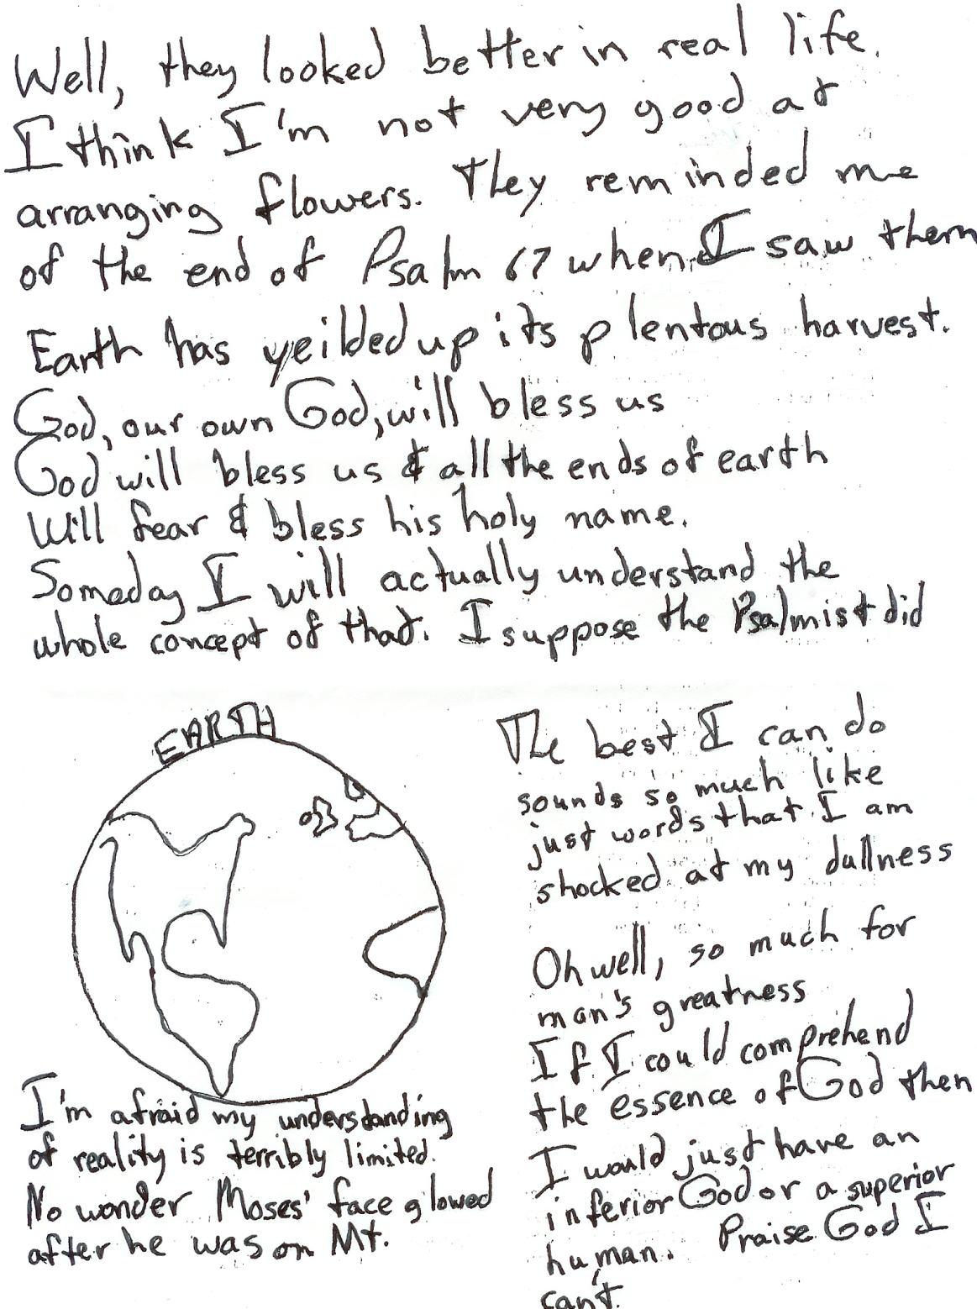

Slide 53
Why is this so important?
What we do with God determines how we interpret life.
Solid and lasting joys are found in knowing God.
You must be dazzled by God to dazzle your kids.
Our children can see and embrace the glory of God.
Beholding his glory transforms us into his likeness.

Slide 54
Showing our Children the Glory of God
What evidence to you see that your children are worshippers?
How can we keep the need to show them God's glory before us all the time?
What gets in the way of showing them God’ glory?
What are temptations to polish their idols? How are your idols similar (or different) than your kid's?
How can you make delighting God a journey to take with your children?

